Slide 1
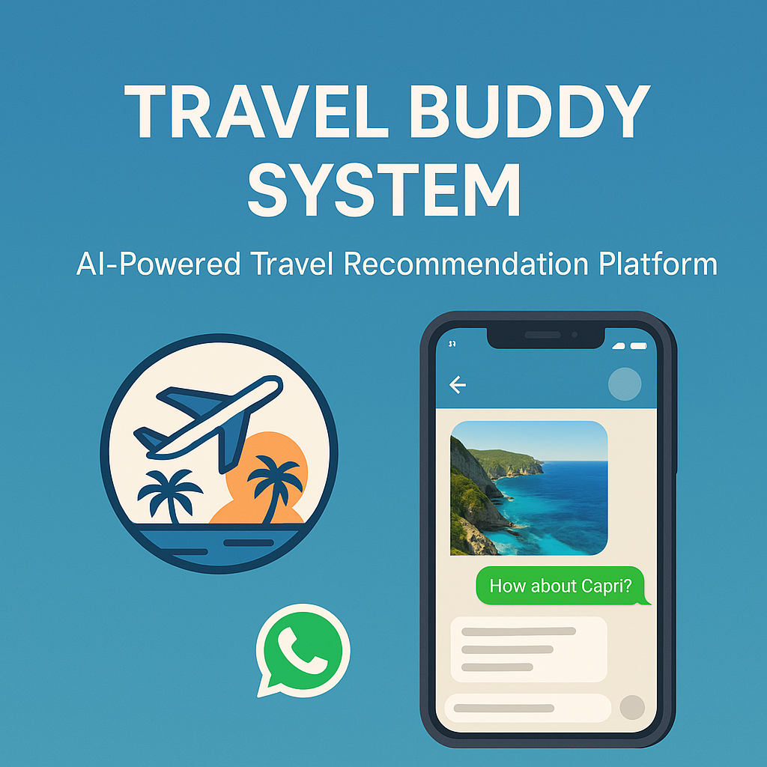
Travel Buddy System

Slide 2
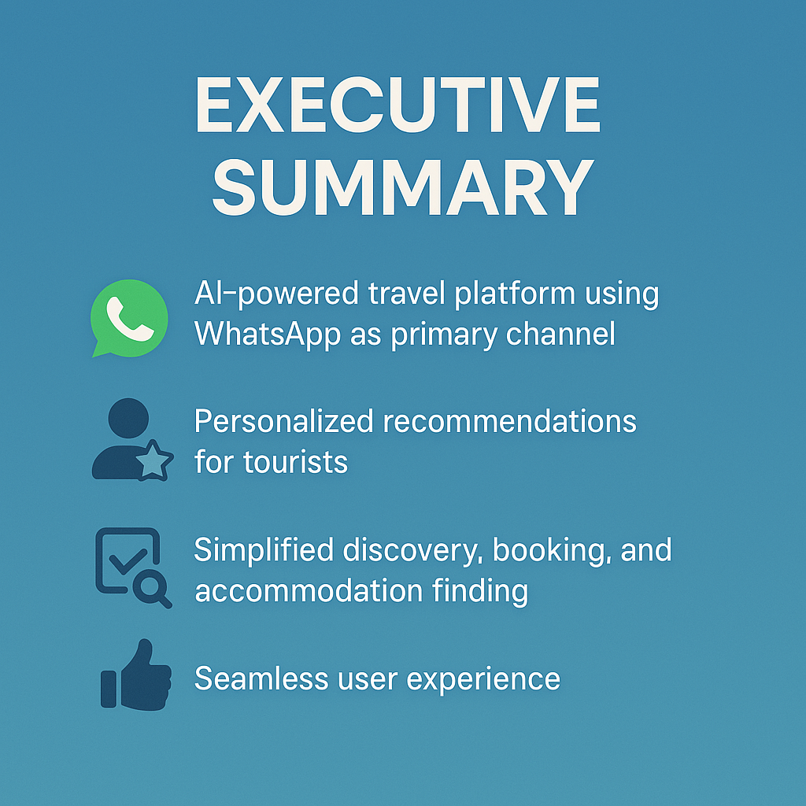
Executive Summary

Slide 3

Market Challenges
Difficulty finding personalized tour packages
Inconvenient booking processes
Limited accommodation recommendations

Slide 4
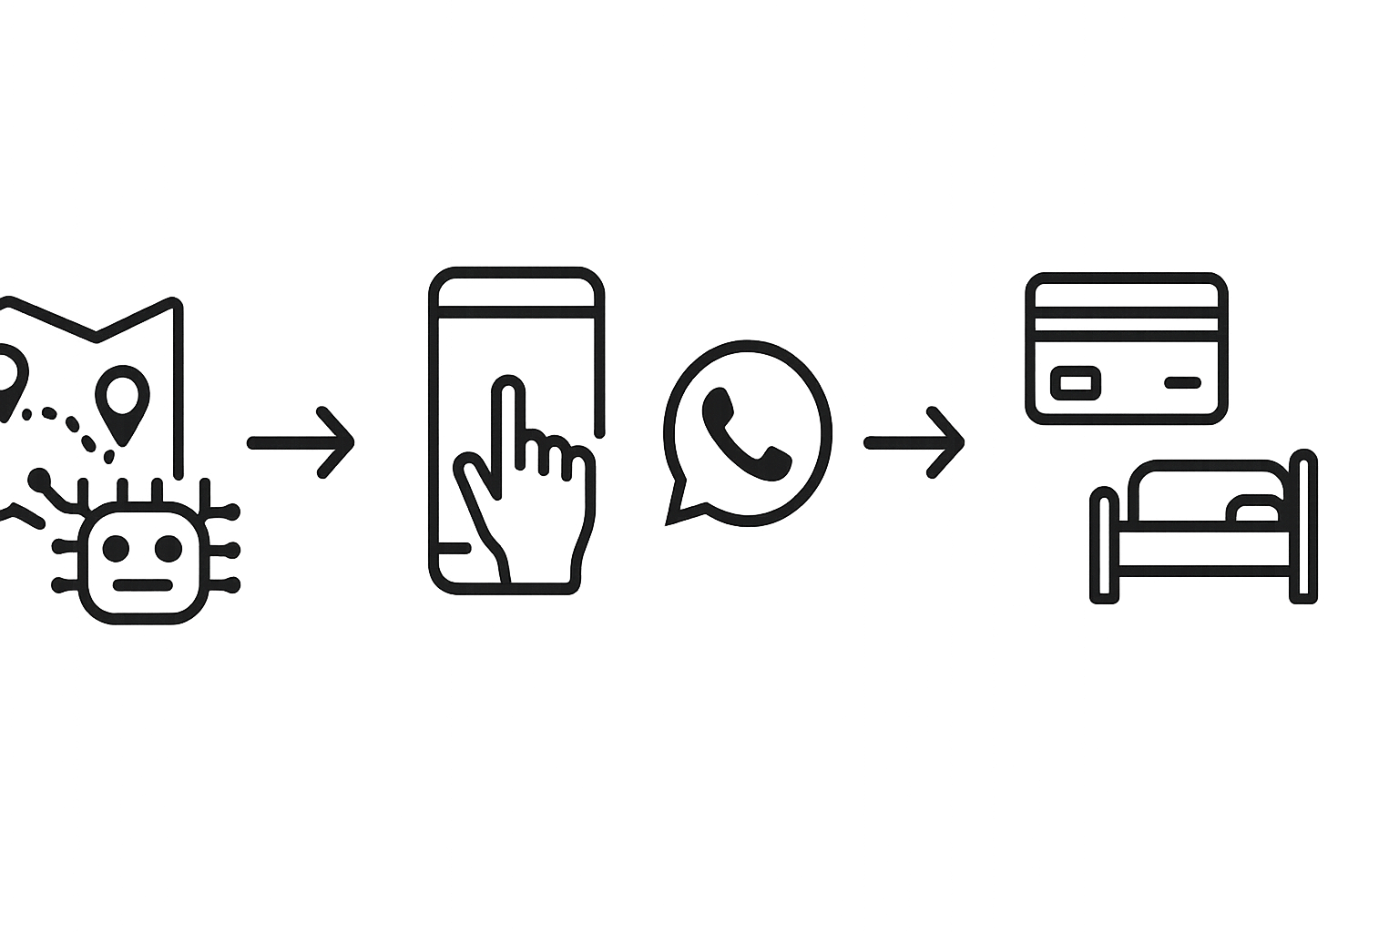
Travel Buddy Solution
AI-driven personalized recommendations
WhatsApp as convenient interaction channel
Simplified booking with clear payment paths
Smart accommodation recommendations

Slide 5
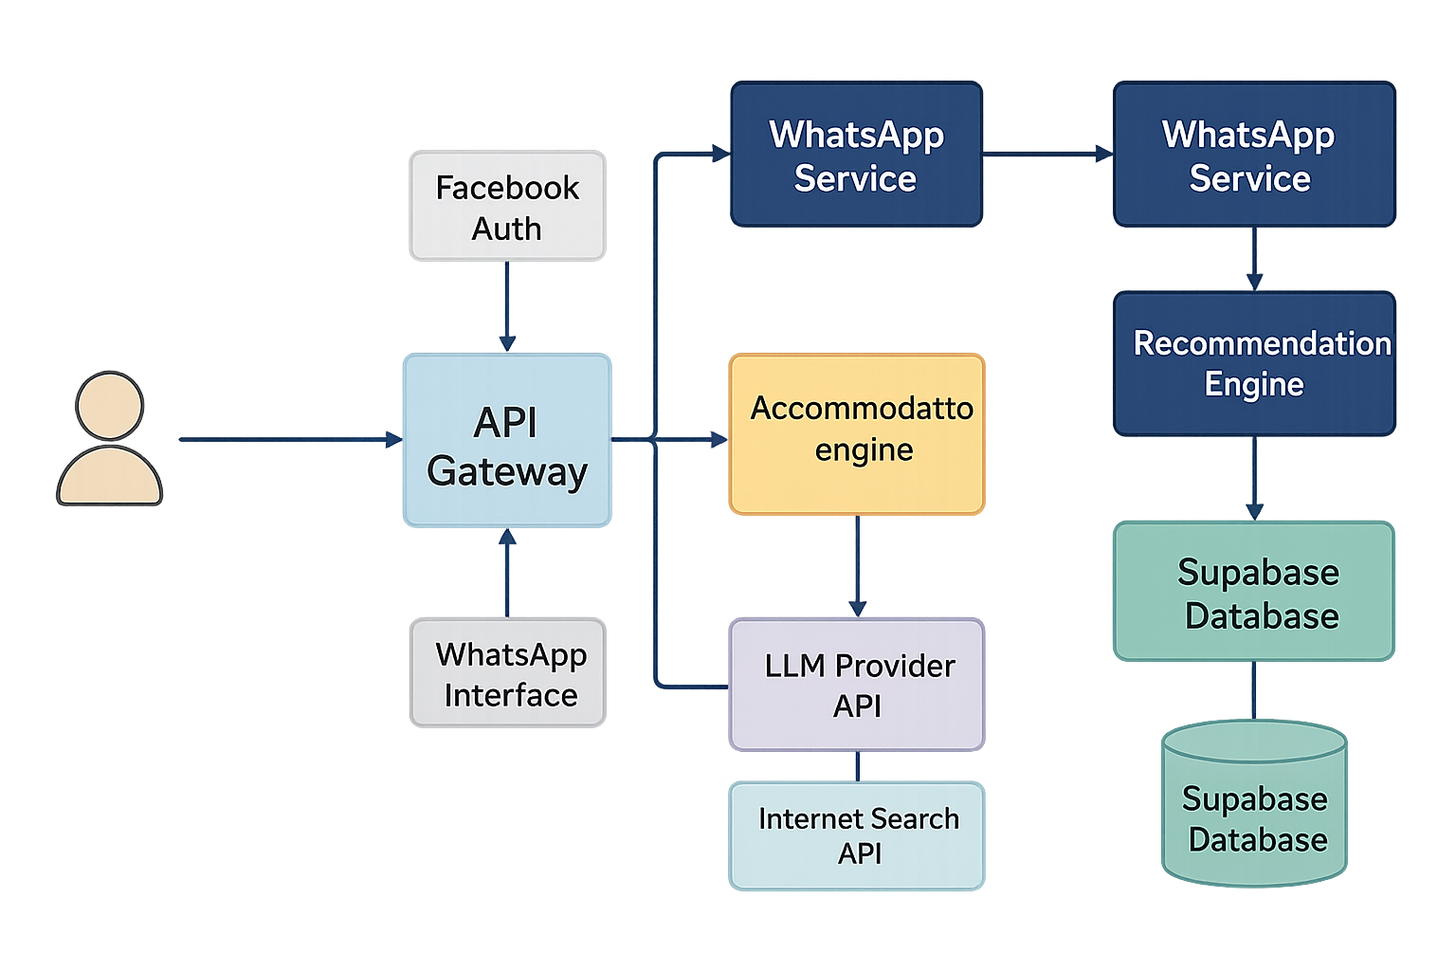
System Architecture

Slide 6
User Interfaces
NextJS web application
User registration and preference input
Responsive design
WhatsApp interface
Recommendations delivery
Interactive communication
Visual: Mock-up screenshots of both interfaces

Slide 7

Backend Services
API Gateway (orchestration, business logic)
Recommendation Engine (LlamaIndex/RAG)
Accommodation Engine (LLM + Search)
WhatsApp Integration Service
Vector Data Processing Pipeline

Slide 8
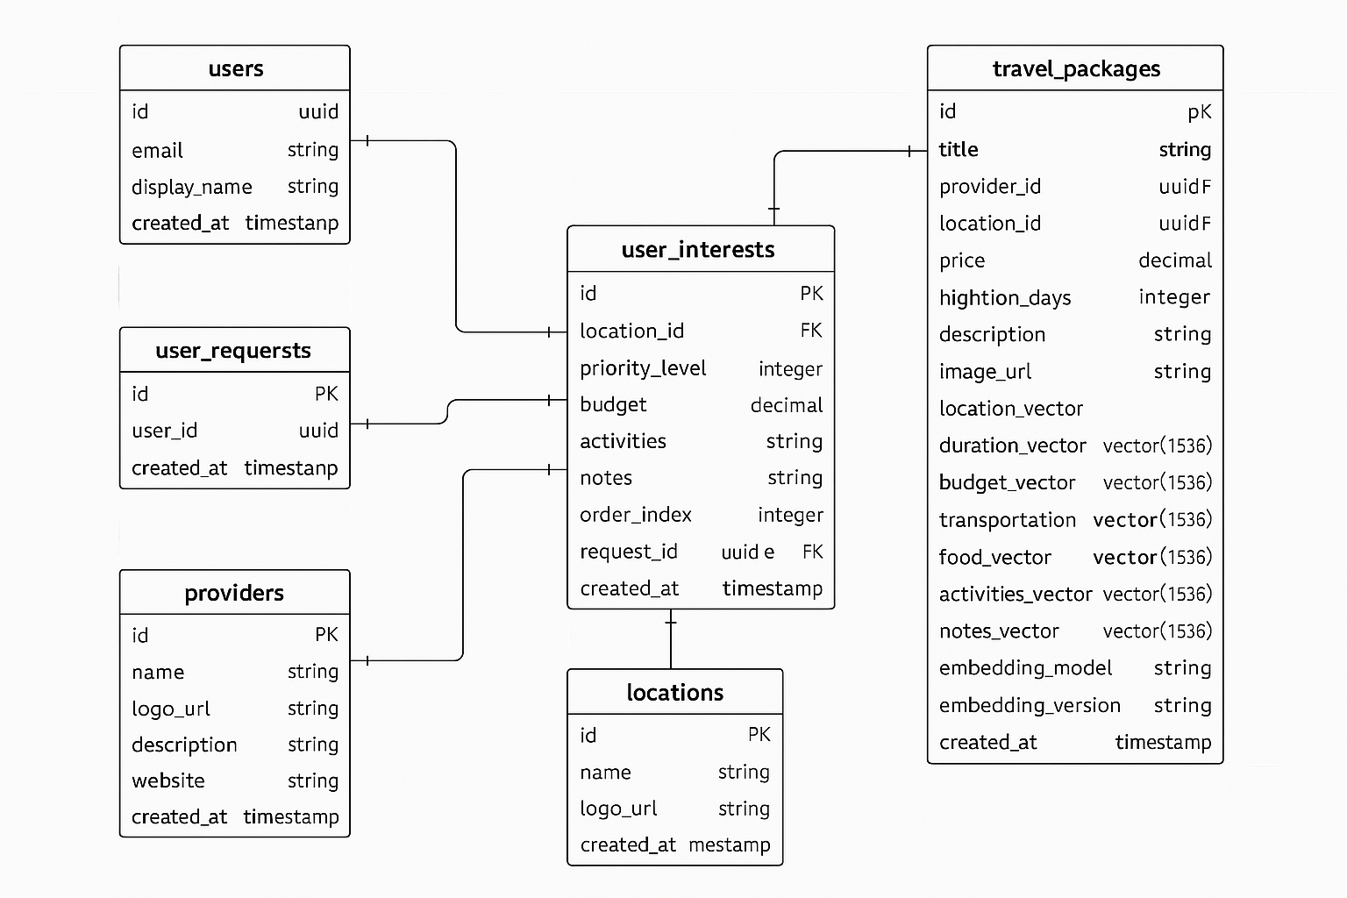
Data Infrastructure
Supabase Database
PostgreSQL with pgvector extension
Vector storage capabilities
Efficient similarity search

Slide 9
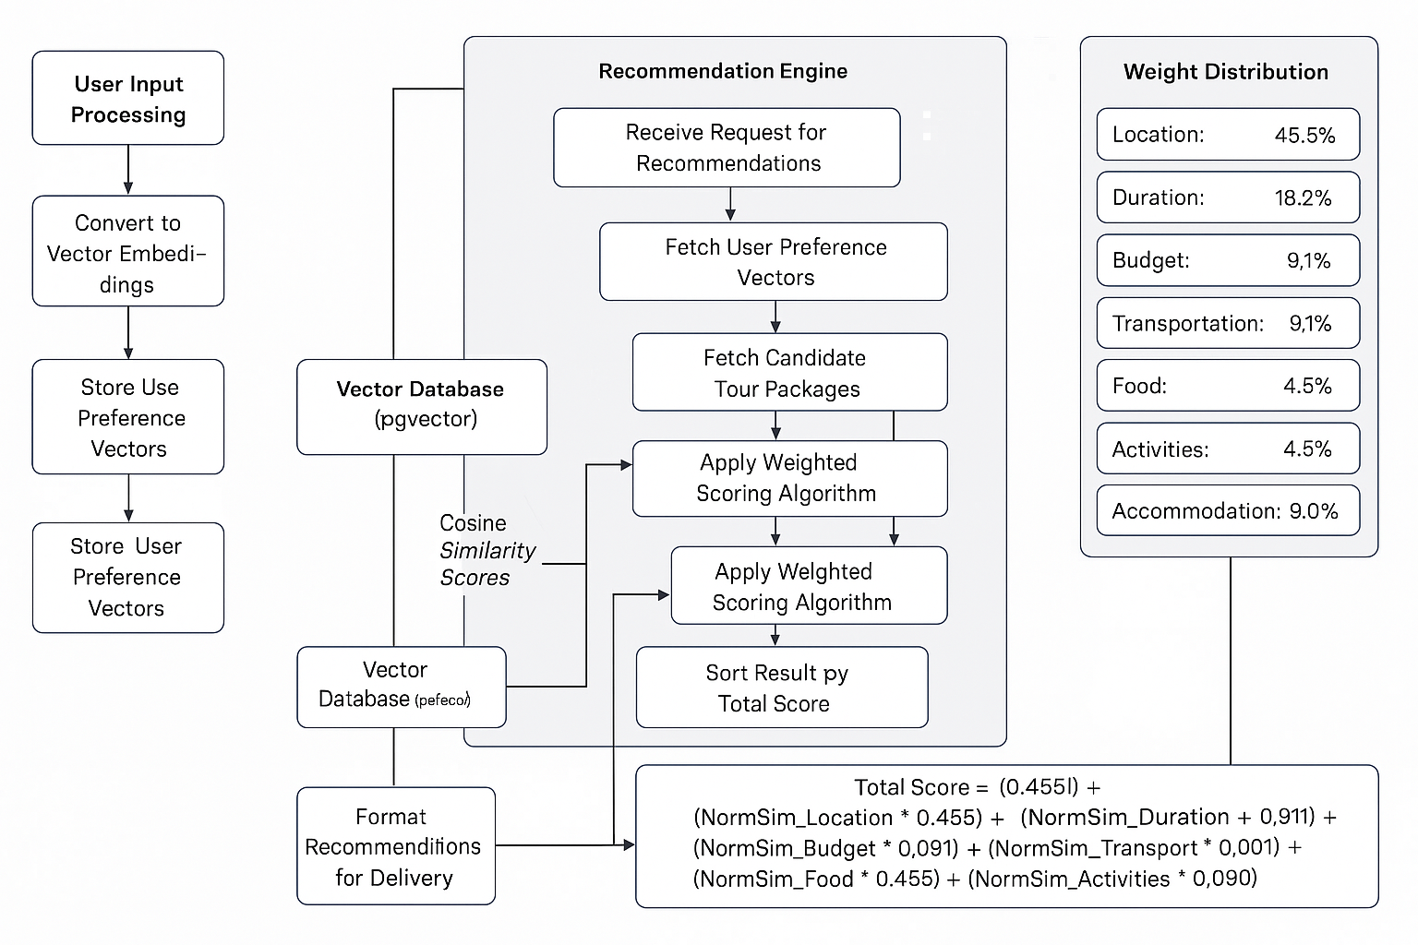
Smart Recommendation Engine

Slide 10
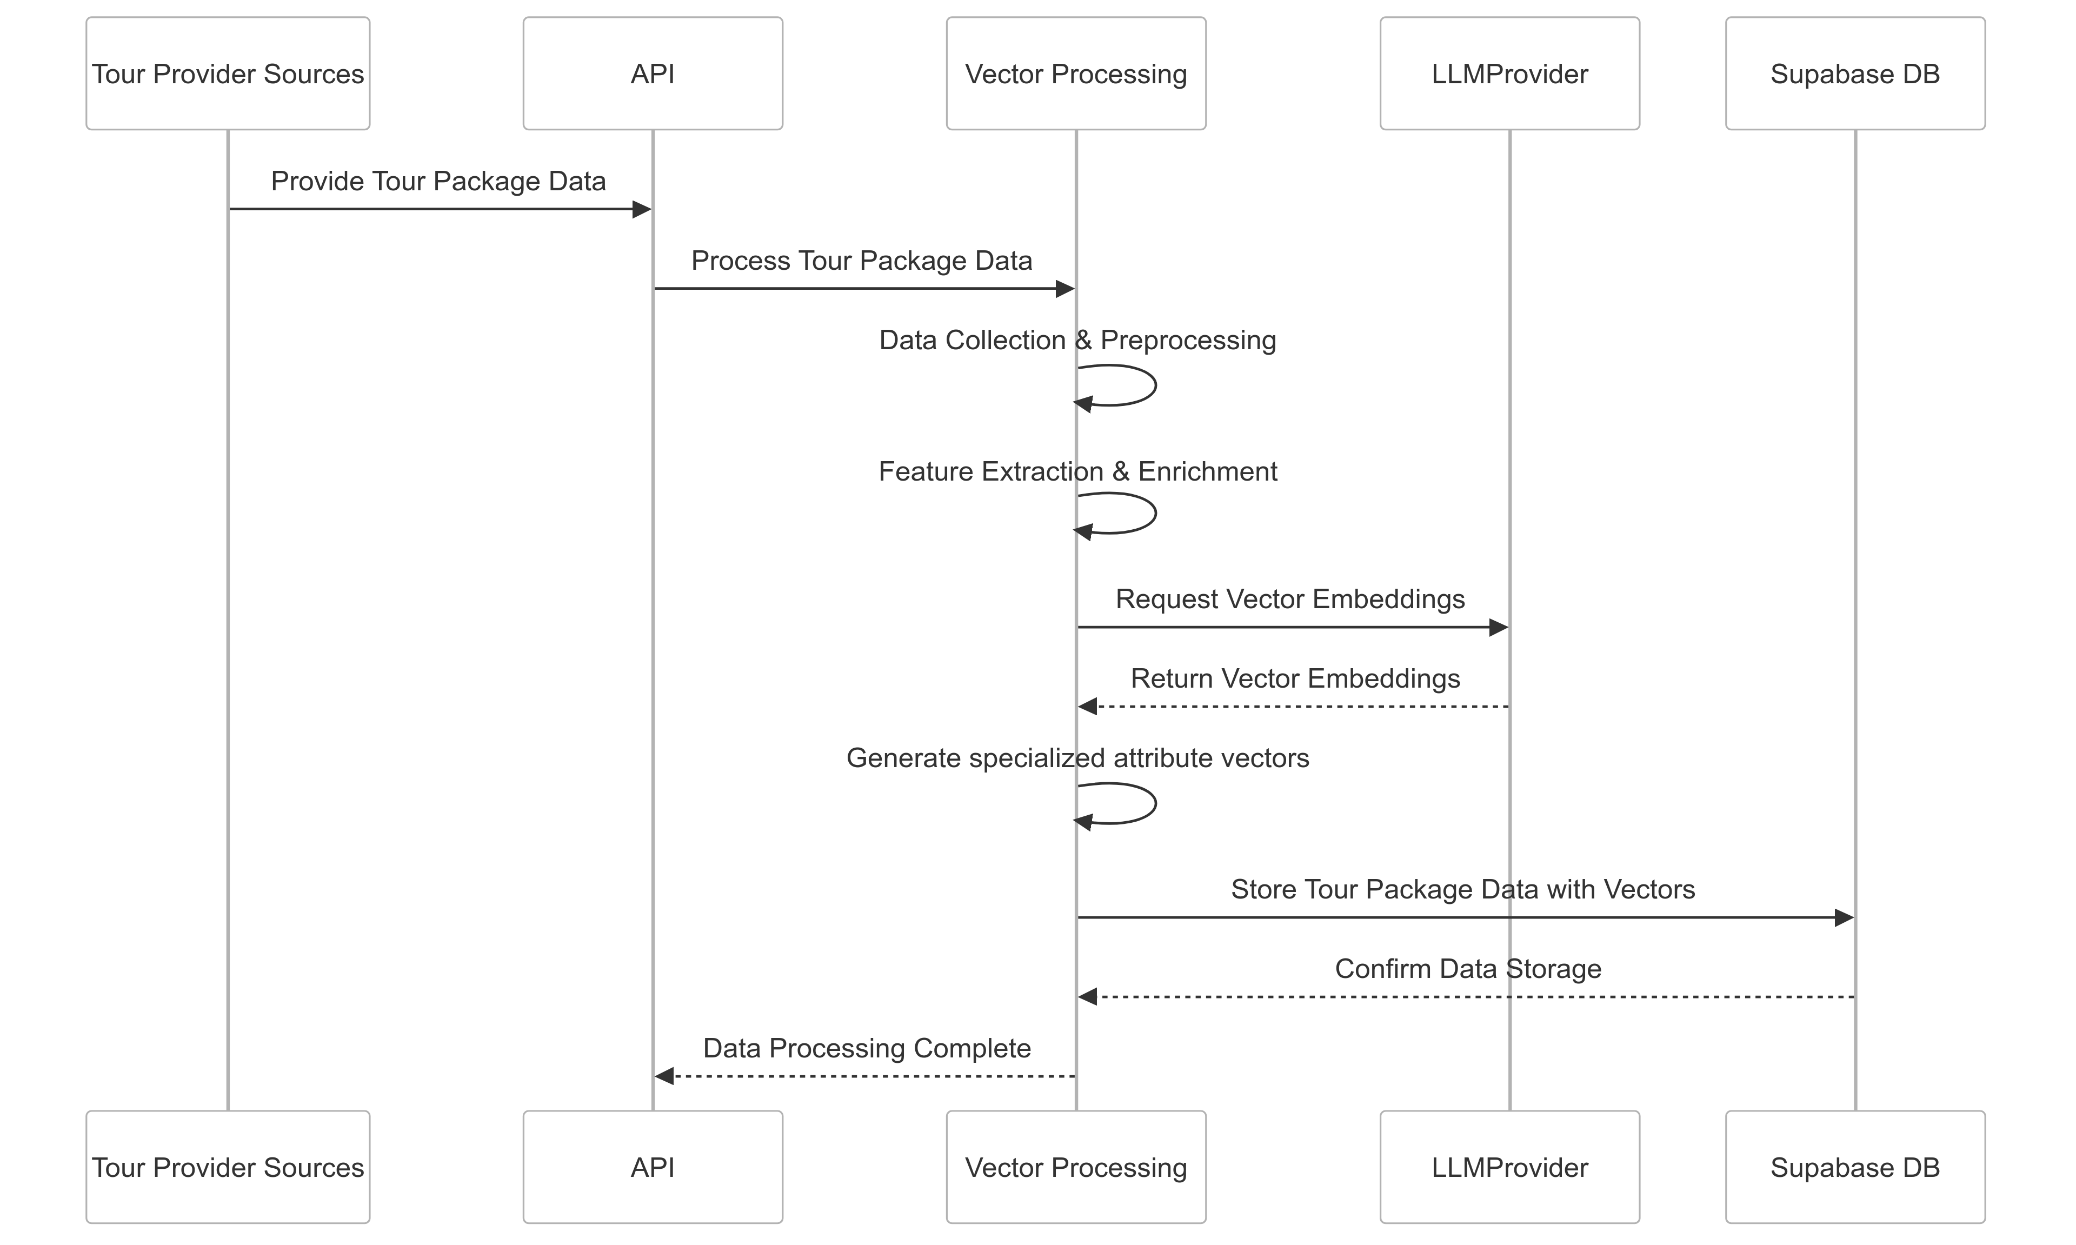
Tour Data Processing

Slide 11
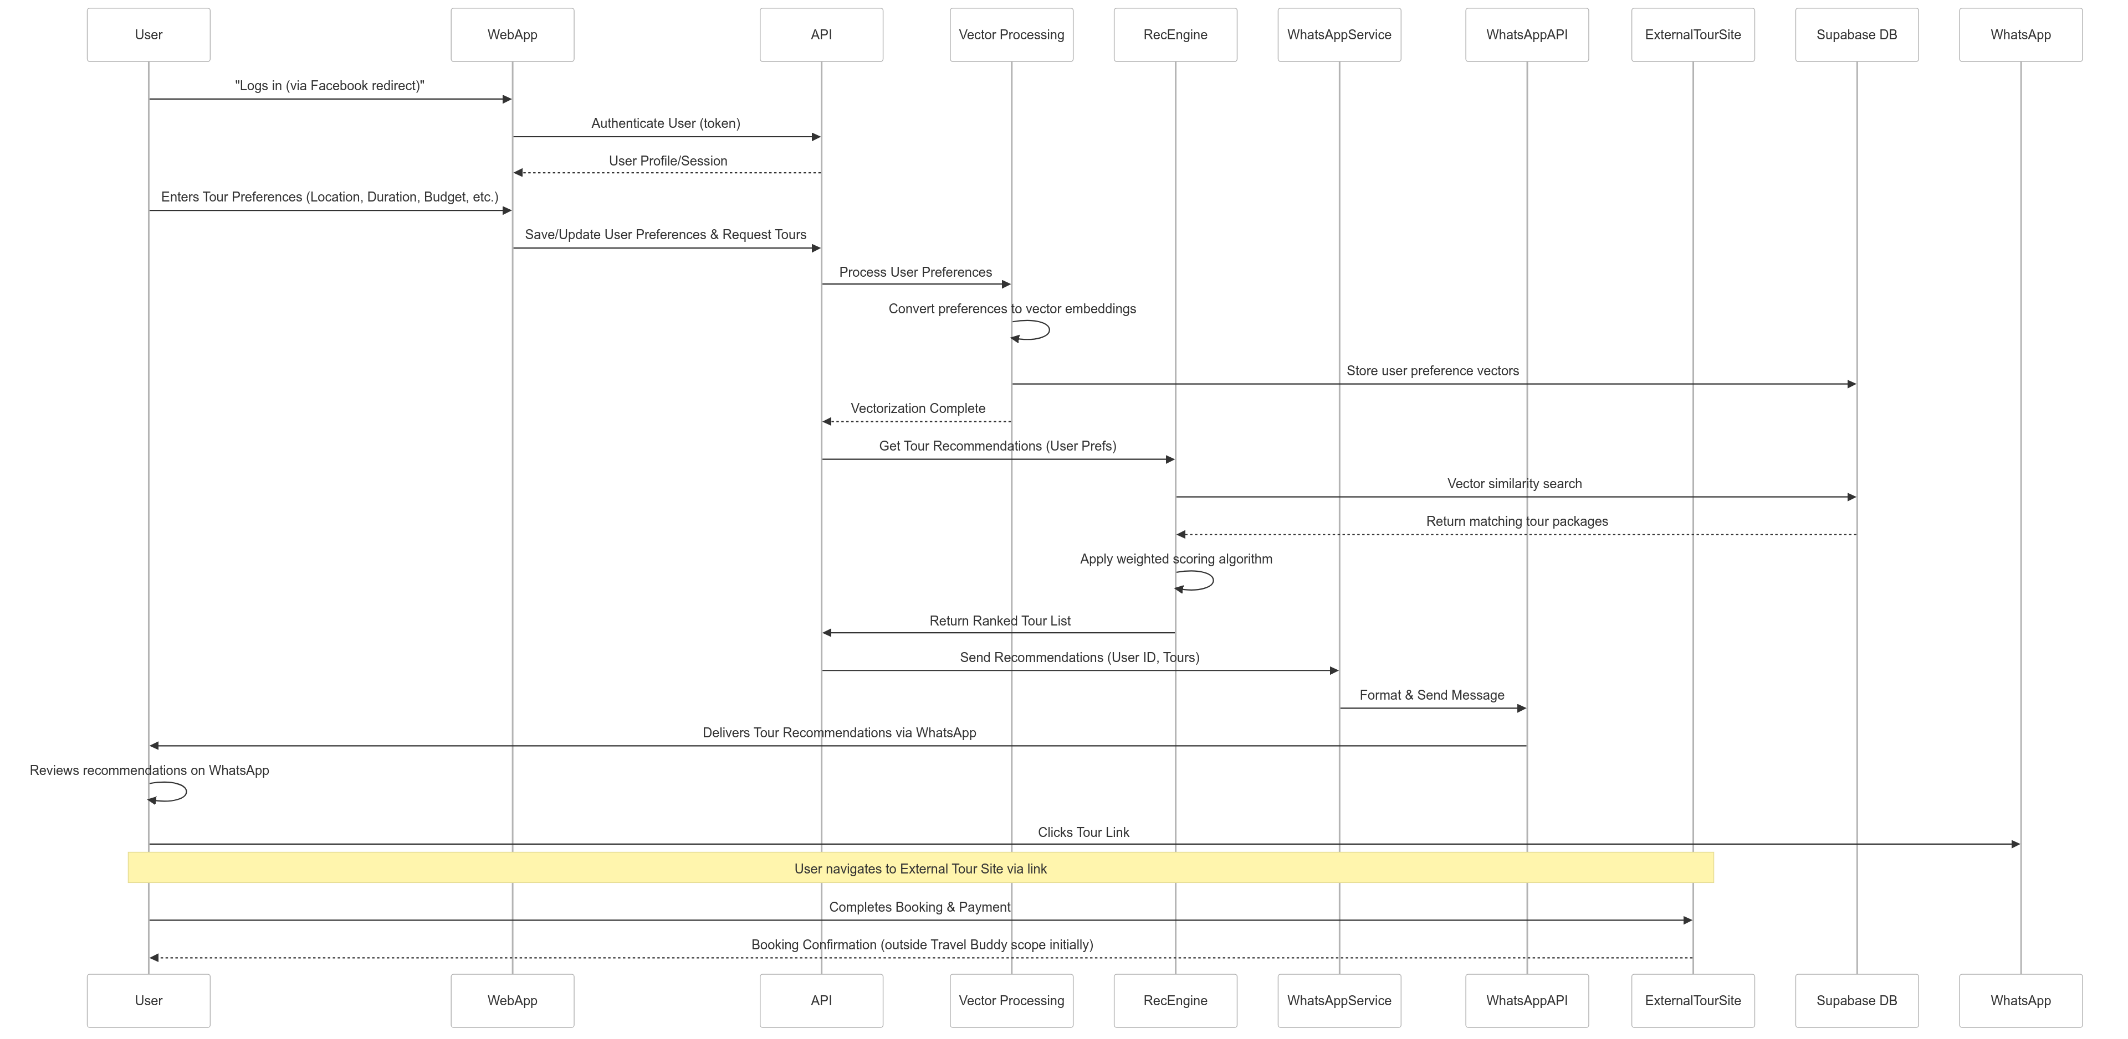
How Recommendations Work

Slide 12
From Search to Booking
Content: Mermaid sequenceDiagram showing booking flow
Visual: User journey map highlighting key steps

Slide 13
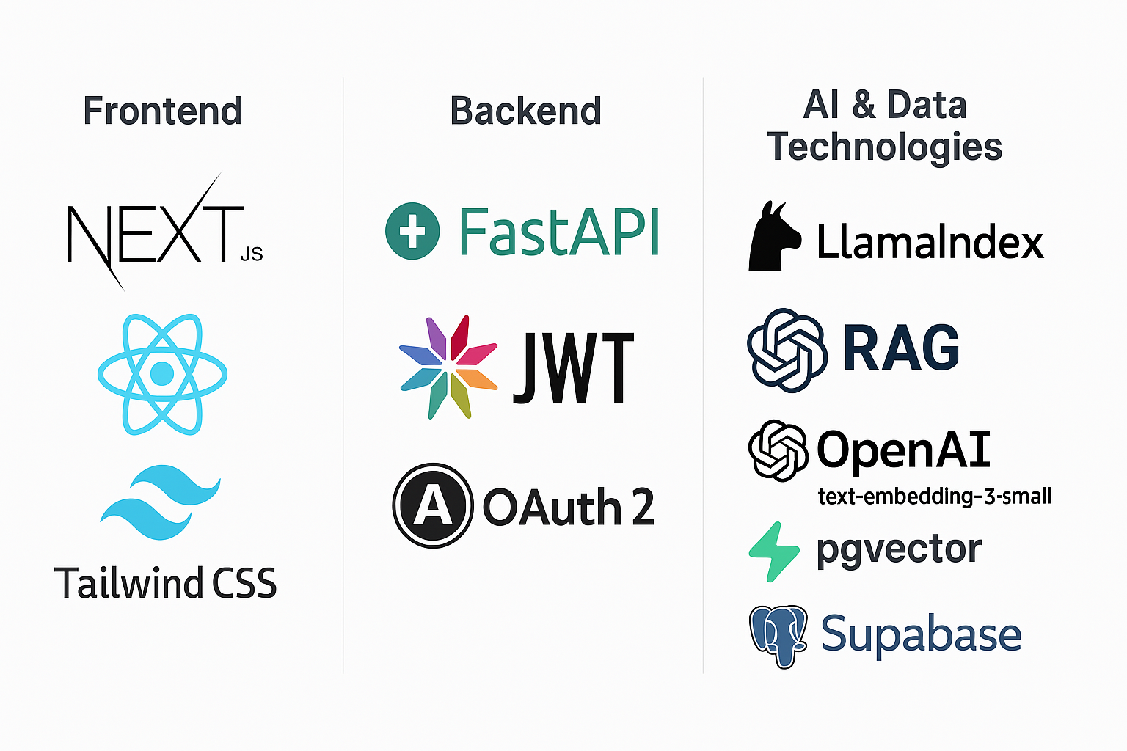
Technology Stack

Slide 14
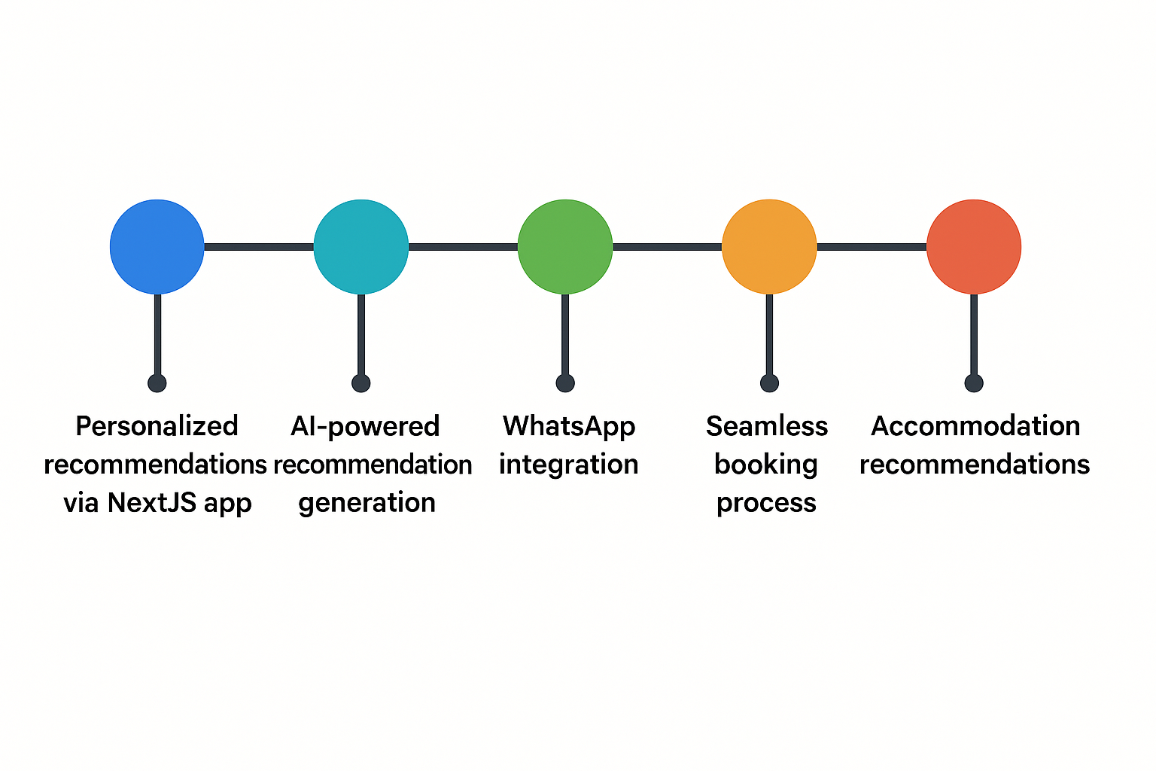
Implementation Plan

Slide 15
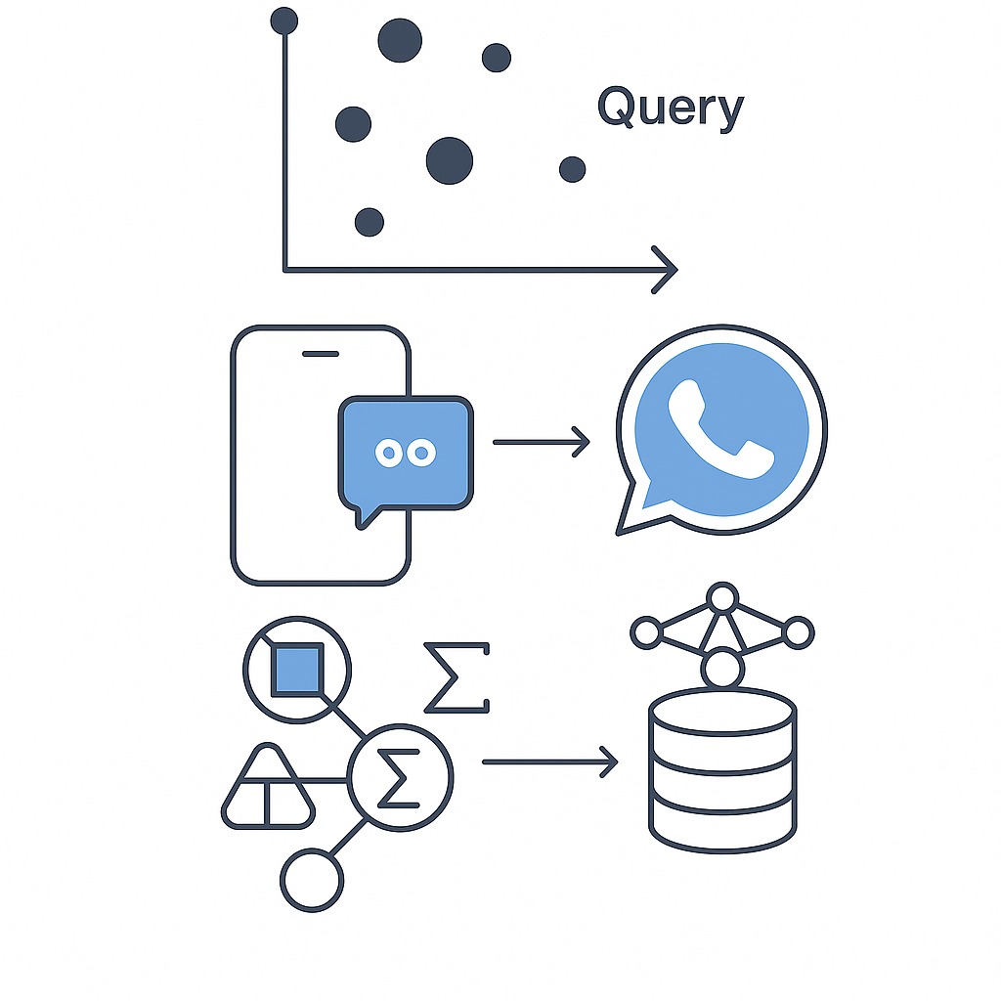
Technical Innovations
Multi-dimensional vector matching
WhatsApp as primary interaction channel
Weighted scoring algorithm
Vector database for semantic search
Separate accommodation engine

Slide 16

Business Value
Enhanced user experience through personalization
Increased engagement via familiar WhatsApp platform
Higher conversion rates with simplified booking
Scalable architecture for future growth
Data-driven insights from user preferences

Slide 17
Next Steps
Content:
Immediate priorities
Future enhancements
Scaling strategy
Visual: Roadmap with milestone markers

Slide 18

Thank You
QA

